Slide 1



Slide 2


Ulisse Tour Operator is a DMC and a local tour operator in Italy, based in Sicily, operating mainly in incoming tourism.
Sicily is our main destination. However, Italy is available on request.

Slide 3
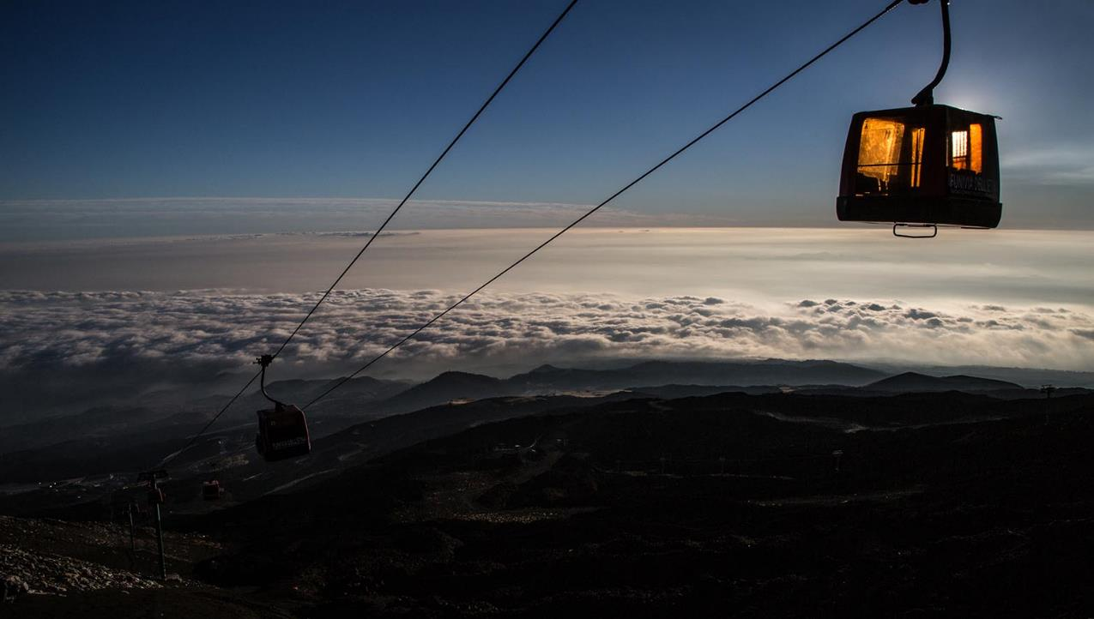
About us:
Born from the combined experience, creativity and passion of three women and their mixed Spanish and Italian backgrounds, the tour operator Ulisse has been offering its clients an unforgettable travel experience through a different vision of Sicily for almost a decade.
Such a mix of cultures is thus reflected in the company's identity, reinforcing its expertise.
In other words, the Ulisse tour operator fulfils the wishes of its customers, creating an interesting combination of style and professionalism.
Ulisse is a tour operator and, thanks to its experience in the travel sector, also a renowned DMC.
We will be happy to organise your congresses, events and incentives for you, because that is our passion!

Slide 4
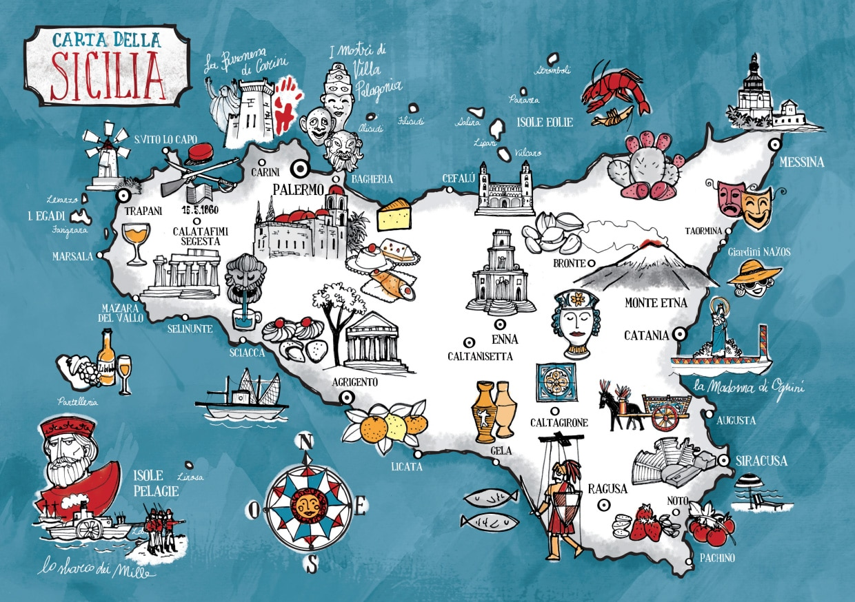

Slide 5
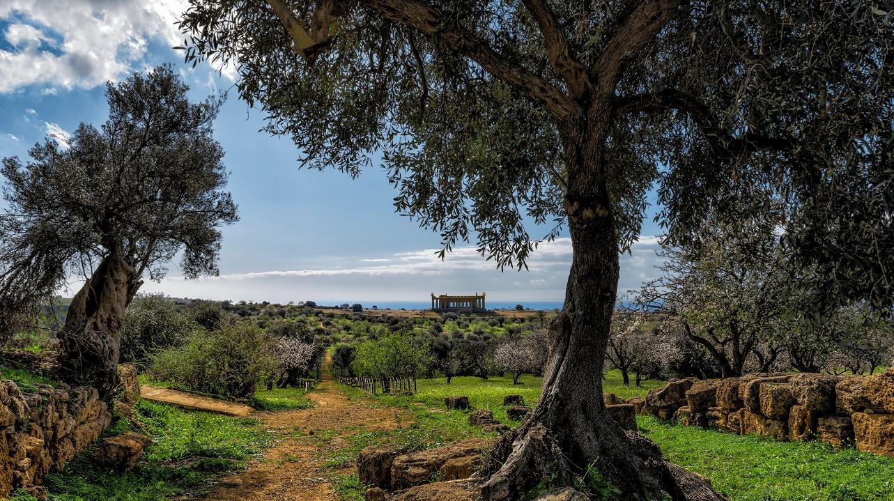
Why a DMC in Sicily?
Because in Sicily you will find everything you ever wanted for a wonderful Mediterranean holiday!
Sicily is the largest island in the Mediterranean Sea. It has a rich historical and artistic heritage and, together with the smaller islands, the Aeolian Islands, Ustica, Egadi, Pantelleria and the more remote Pelagie Islands, it is the largest region in Italy.
You will find a mixture of culture, nature and art with the most beautiful landscapes you could ever imagine and a mild climate from April to October. Four international airports: Catania and Comiso (eastern Sicily), Palermo and Trapani (western Sicily), are well connected to all national roads and many European capitals.

Slide 6
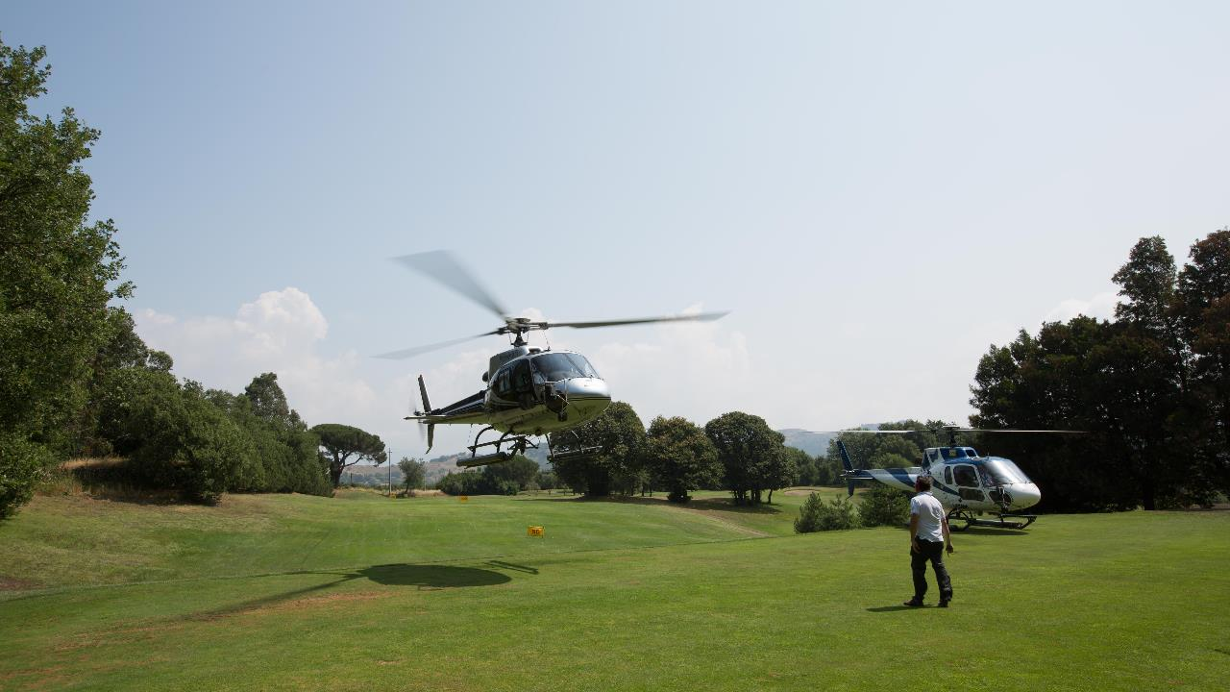
Ulisse Tour Operator deals with MICE in Sicily. We will be happy to organise whatever you need in Sicily. MICE is vital for us and Sicily is a perfect destination for these MICE activities.
We offer an unforgettable travel experience through a different vision of Sicily and Italy, creating an interesting combination of styles and professionalism and offering all the colourful sides of Sicilian traditions: art, culture, food, wine and nature.

Slide 7
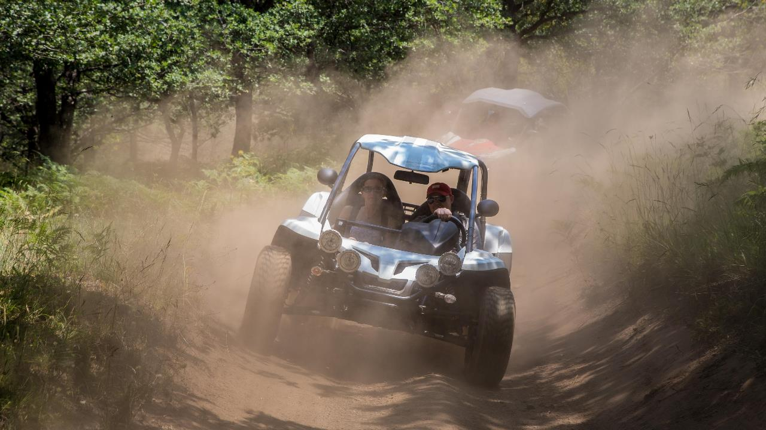

Slide 8
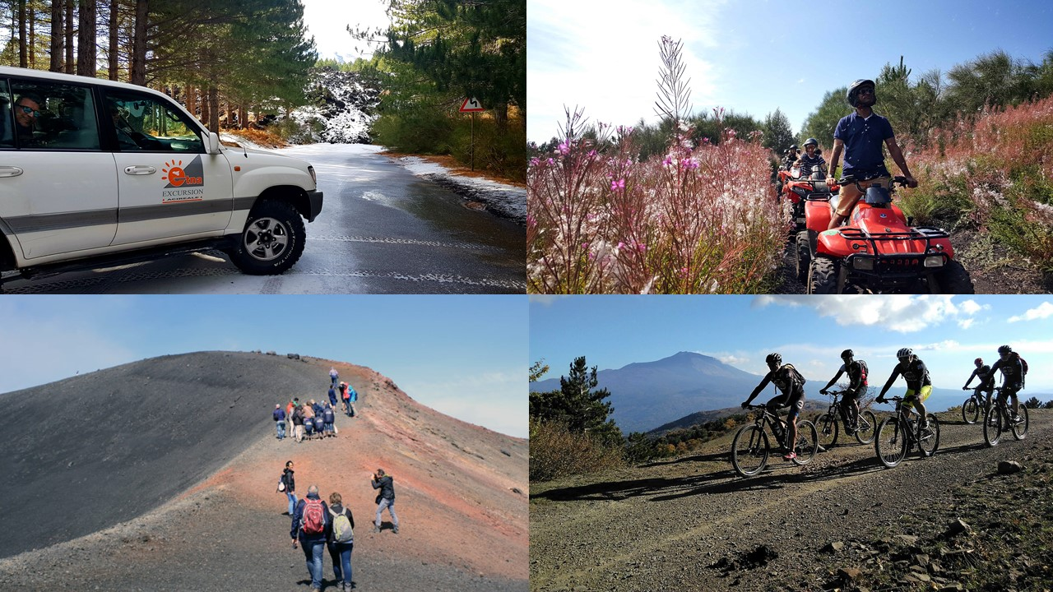
Enjoy your stay by combining
Sicilian flavours with activities
unique and unconventional activities!
So many options, so many possibilities...
We will create a tailor-made match between your needs and your desires!

Slide 9
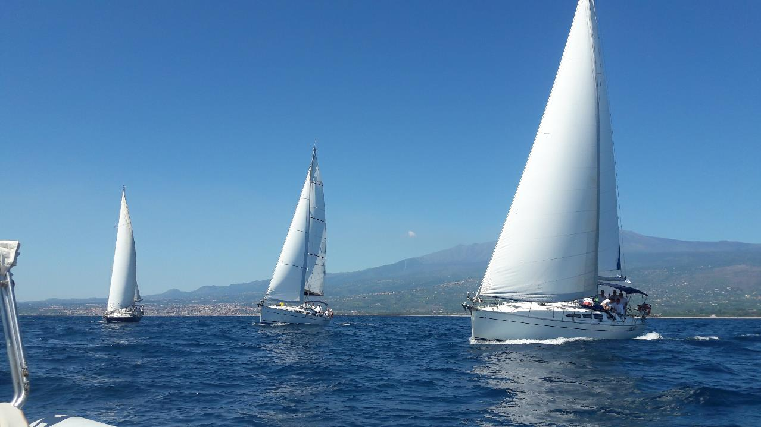

Slide 10
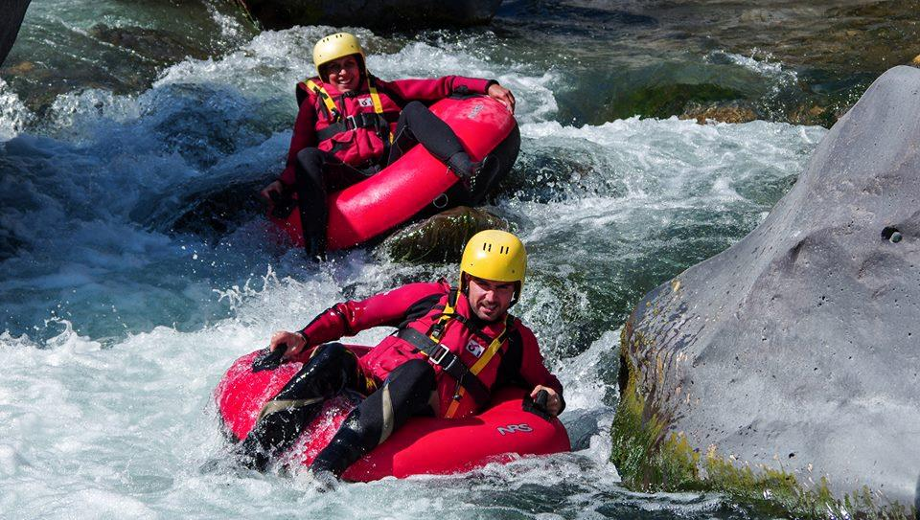
Treasure hunt
Cooking courses
Orienteering, kayaking, canyoning, rafting, hydro-speed, mountain biking
Fishing, beach volleyball or football challenges
Dynamic excursions
Boat trips, cruises and regattas
Unique and unconventional transportation
Wine and food tasting...
and much more!

Slide 11
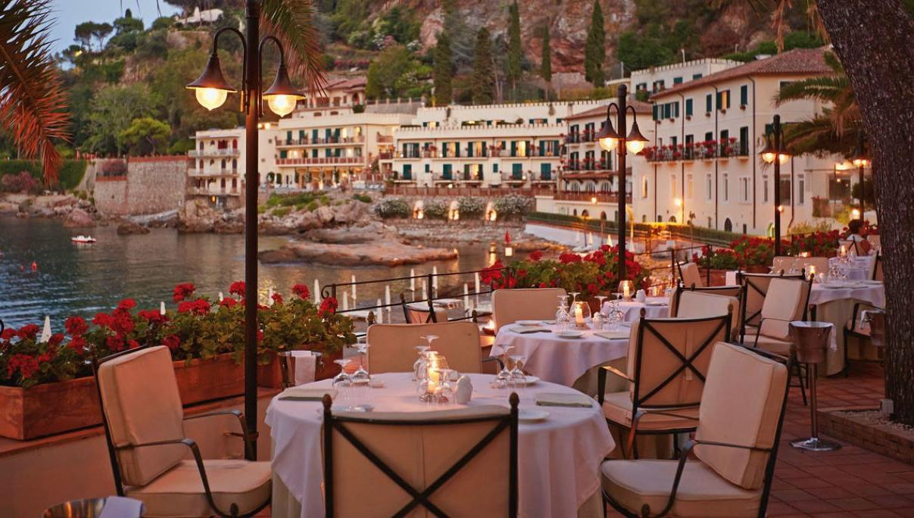
Hospitality is our art!
We work with the best establishments to ensure that your stay is fabulous and that you
fabulous stays and allow you to enjoy all the magnificence of the island

Slide 12
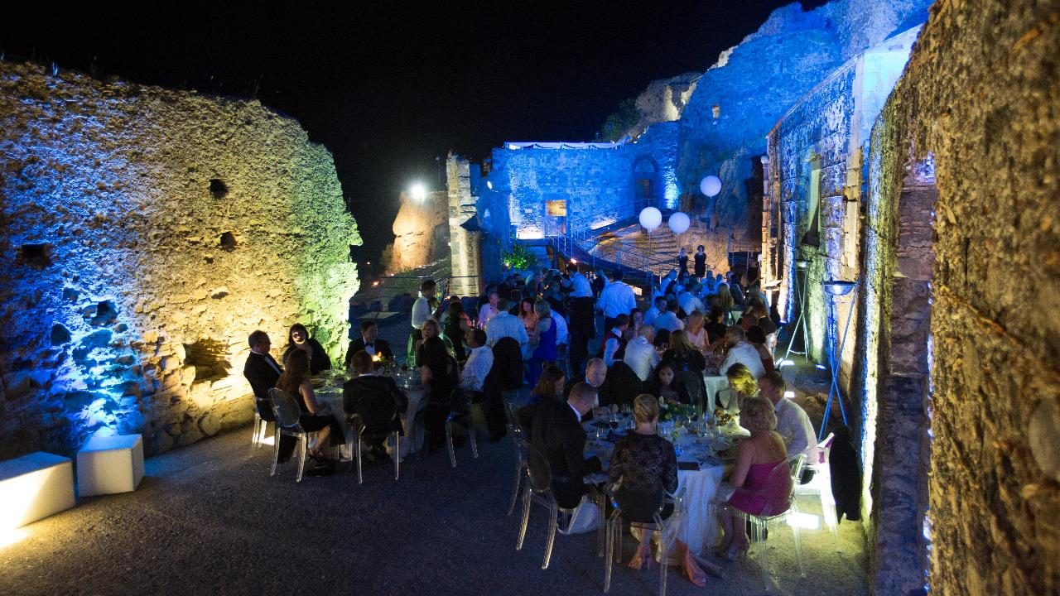
Enchanting atmospheres in incomparable landscapes, some built in the characteristic Sicilian baroque style, the residences of the last "Gattopardi", others very modern, with state-of-the-art technology.

Slide 13
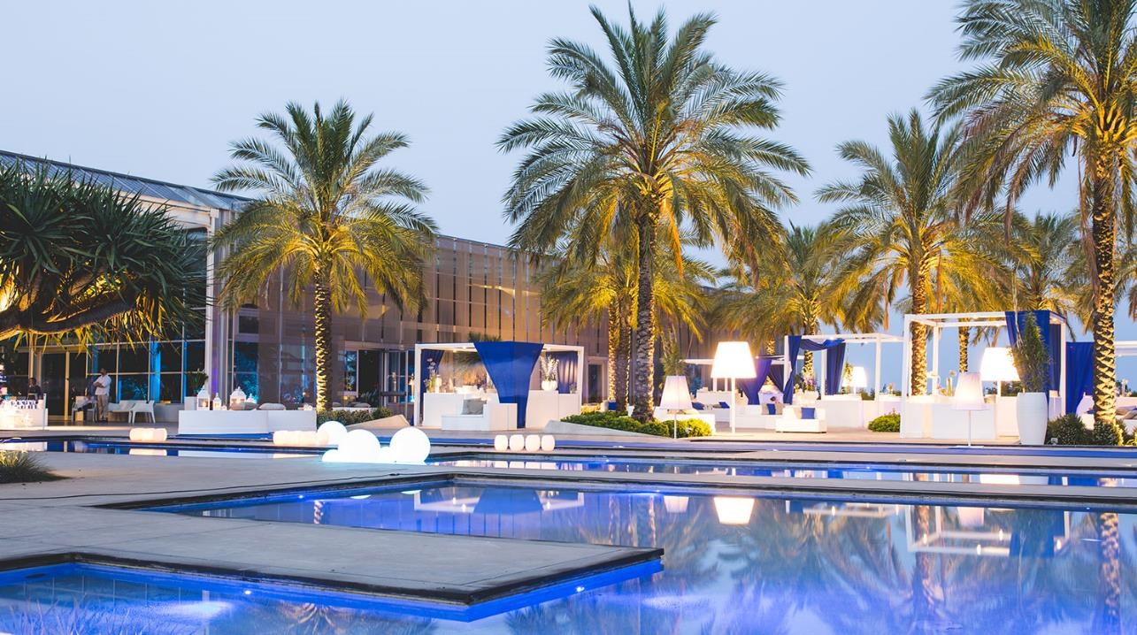

Slide 14
















Some of our clients

Slide 15

The Spanish influence is the last; the first is Greek, the second and third are Saracens and Normans; the Renaissance has only hints here. Mix these various cultural elements with a dazzling sun, African soil, a lot of dust and wonderful vegetation, and you have Sicily.(Karel Čapek)
www.ulissetouroperator.com

